Slide 1


Традиції святкування Різдва у країнах європи.
Традиції і звичаї європейських країн
Підготували учні 9 класу: Ландяк Олеся, Ландяк Микола, Тарнавська Діана, Мурин Юрій, Ванджура Юрій, Крамарчук Андріана.
Вчитель англійської мови: Рижевська О.В

Slide 2

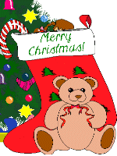

Great Britain
In Great Britain people appreciate traditions most of all. Everybody listens to Short Speech of the Queen, she says right after Christmas dinner. Before gather at the festive table, the whole family goes to church. Children become presents from Father Christmas. On New Year in Britain there is the custom of "admission of the New Year." When the clock begins to beat 12 - open the back door of the house to let the old year go away and with the last strike open the front door to let the New Year come in.

Slide 3

Austria
Austrians traditionally celebrate Christmas with family. They decorate Christmas tree with chocolate and marmelade. People don‘t lock the front door – anytime friends can come and celebrate together.

Slide 4

Belgium
In Belgium people believe in the "magic of the first day“. The behavior of a man in the first day that it has to be in the new year. So, they try not to borrow anything that day, put on something new.

Slide 5
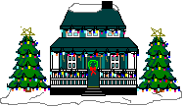
Bulgaria
Preparation for Christmas in Bulgaria begins for advance. Women bake bread and men cut the pig. Master of the house prepares for celebration thick log fire, which represents the "Young God".
When he burns a fire, a log is placed in the middle. After the dinner carols begins. Bulgarians gathered for Christmas celebration switch off the light for a few minutes. These moments are called moments of Christmas kisses, mystery of which keeps the darkness.

Slide 6



germany
Christmas is a family holiday in Germany. The whole family should certainly gather at the festive table. This day is ceremony gifts, even has a name - die Bescherung - Besherunh. The main dish of the New Year feast is der Lebekuchen - Gingerbread. In Germany people often give glass or porcelain pigs, which are piggy banks.

Slide 7

Greece
On Christmas Eve, a small Greek children go from house to house to greet with Christmas, and sing "kallanda" (traditional Christmas songs) for receiving in exchange sweets and dry fruit. When people visit their friends they take a stone, which leave at the threshold of the house, where they came. If the stone is heavy, they say: "Let the wealth of the owner will be as heavy as this stone." If the stone is small, they say "Let problems of the owner will be as small as this stone."

Slide 8

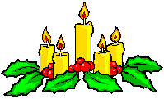
Ireland
In Ireland Christmas is a family holiday, where all family members gather together to celebrate the birth of Christ. An interesting tradition on Christmas Eve is lit the candle on the window as a sign of readiness to take Joseph and Mary, who in this frosty night can not find room for the birth of the Son of God. Also, all exchange small gifts. The traditional dish is "Irish soup".

Slide 9


Spain
Most Spaniards must attend Christmas Mass.
After the Mass many Spaniards go to their favorite restaurant to celebrate Christmas in the circle of relatives and friends. In Spain, the celebration of the New Year is traditionally on the central square near a large tree. People eat grapes. When the clock strikes everybody tries to eat 12 grapes. Each vineyard symbolizes one of the coming months.

Slide 10
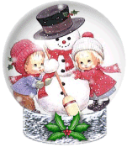
italy
Christmas in Italy - a mixture of pagan and Christian traditions. Until now, on the Christmas people set fire to a large piece of wood, which should burn until the New Year. According to pagan faith burning logs embodies clearing people from all evil, evil destruction and seeing the old year. In Italy on the New Year's Eve people throw out old things and buy new instead. If there is no old things, you have to throw new ones because happiness will pass the house.

Slide 11
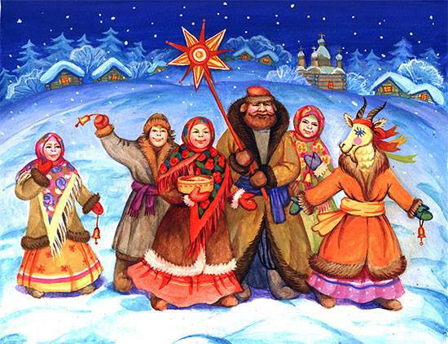
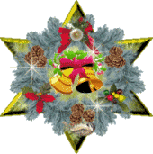
Ukraine
In Ukraine we have a lot of different traditions of celebrating Christmas. Families gather together, have Christmas supper. We have 12 traditional dishes. Among them are kutia, varenyky, uzvar. We sing koladkas and perform verteps.

